Slide 1


Slide 2
Completing the Accounting Cycle

Slide 3
Accrual Accounting
Accrual Accounting
LO1
Example
In 2017, two brothers sign a contract. The total contract price is $20,000.
The brothers do most of the consulting work in 2017 and finish the job in 2018. They receive a $2,000 cash payment from the contract in 2017 and receive the remaining $18,000 cash in 2018.
On December 31, 2017, the brothers prepare a 2017 statement of comprehensive income to use in applying for a bank loan. What amount of revenue should the brothers report for 2017?

Slide 4
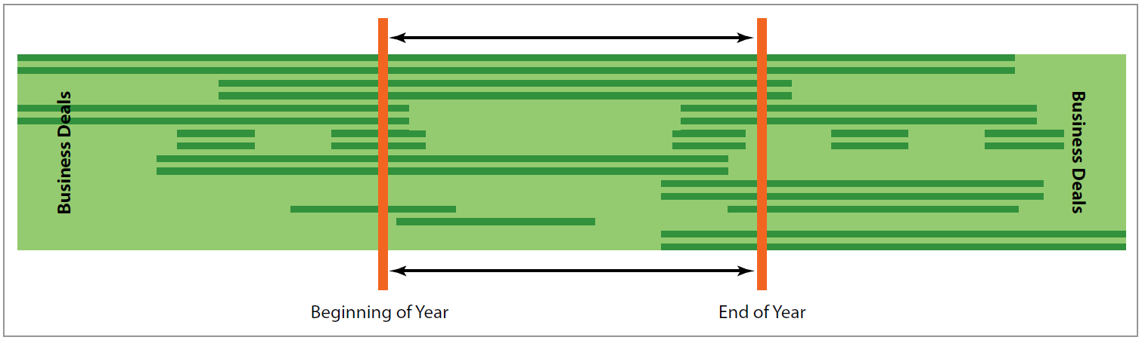
Accrual Accounting
LO1
Example
Estimate the amount of the work completed in 2017.
The brothers can’t wait until the final contract payment is received.
Exhibit 4.1

Slide 5
Periodic Reporting
LO1
Time-period Assumption
The idea that the life of a business is divided into distinct and relatively short time periods so that accounting information can be timely.
Companies issue a report to stockholders annually or even on a quarterly basis.

Slide 6
Periodic Reporting
LO1
Fiscal Year
An entity’s reporting year, covering a 12-month accounting period.
Calendar Year
Reporting year that is from January 1 to December 31.
January 1
December 31

Slide 7
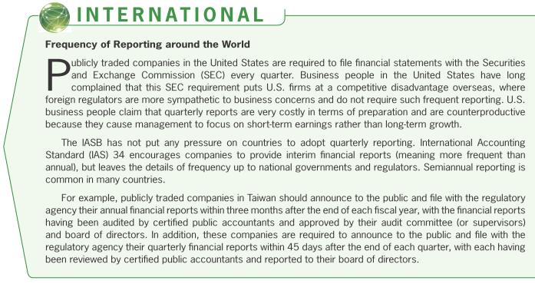
Periodic Reporting
LO1

Slide 8
Accrual Accounting
LO1
Revenues: Recognized (recorded) when certain criteria are satisfied without regard for when cash is received.
Expenses: Recorded as incurred without regard for when they are paid.

Slide 9
Accrual Accounting
LO1
Revenue Recognition
For a sale of goods to be recognized as revenue, while:
The amount of revenue and the costs incurred or to be incurred should be reliably measurable.
It is probable that the economic benefits (in most cases, cash) from the sale will flow to the seller.
The seller should not continue managerial involvement in or maintain control over the goods.
The rewards and significant risks associated with owning the goods should be transferred to the buyer.

Slide 10
Accrual Accounting
LO1
Revenue Recognition
For a service to be recognized as revenue, while:
The economic benefits from rendering the service will probably flow to the provider.
The amount of both the revenue and the costs incurred (or to be incurred) can be measured reliably.

Slide 11
Accrual Accounting
LO1
The Matching Principle
Revenue are recognized!
Related costs and expenses should be recognized.
Assets are decreased
or liabilities are increased.
Related costs and expenses should be recognized.
Prepaid Insurance is decreased.
Insurance Expense is increased.

Slide 12
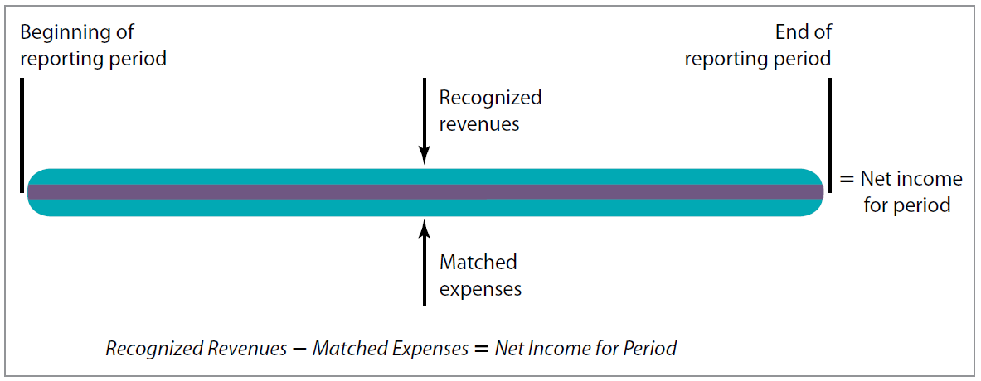
Accrual Accounting
LO1
Determining Accrual Income
Exhibit 4.2

Slide 13
Accrual- versus Cash-Basis Accounting
LO1
Cash-Basis Accounting
A system of accounting in which transactions are recorded and revenues and expenses are recognized only when cash is received or paid.

Slide 14
Accrual- versus Cash-Basis Accounting
LO1
Example
During 2017, Karas Brothers billed clients $50,500 for consulting services performed in 2017.
By Dec. 31, Karas had received $22,000 in cash from customers, with the $28,500 balance expected in 2018.
During 2017, Karas paid $21,900 for various expenses that had been incurred.
At Dec. 31, 2017, Karas still owed $11,200 for salary expenses incurred. These expenses will be paid during January 2018.

Slide 15
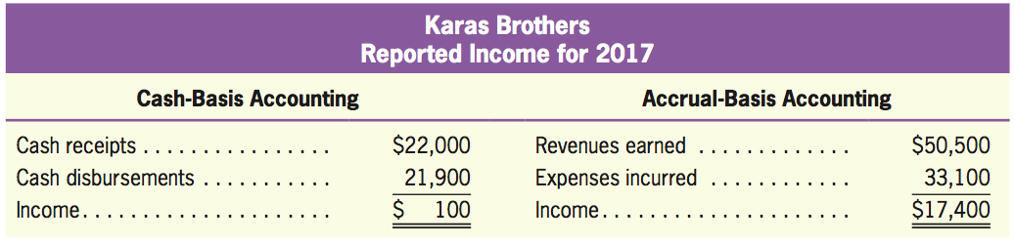
Accrual- versus Cash-Basis Accounting
LO1
Example
Determine net income under both methods.
Accrual-basis accounting is required by GAAP.

Slide 16
Quiz Yourself
LO1
For each of the following items, state the amount of revenue that should be reported in the current year. Each of the items is independent of the others.
On October 11 of the current year, the company received $20,000 in cash in advance for consulting services to be provided in the future.
By December 31, services worth $8,000 had been provided. The additional $12,000 in services will be provided next year.
$8,000 revenue should be reported in the current year.

Slide 17
Quiz Yourself
LO1
On November 6 of the current year, the company provided services worth $12,000.
By December 31, cash of $5,000 had been collected. The additional $7,000 in cash will be collected next year.
$12,000 revenue should be reported in the current year.

Slide 18
Quiz Yourself
LO1
On November 17 of the current year, the company signed a contract to provide services worth $10,000.
By December 31, services worth $4,000 had been provided and cash of $3,000 had been collected. The remaining $6,000 in services will be provided next year, and the remaining $7,000 in cash will be collected next year.
$4,000 revenue should be reported in the current year.

Slide 19
Adjusting Entries
Adjusting Entries
LO2
Required at the end of each accounting period to adjust the accounts to their proper amounts, on an accrual basis.
Needed after careful analysis of revenues to be recognized and expenses incurred.
Each adjusting entry involves at least one account on the statement of comprehensive income and one balance sheet account.

Slide 20
Adjusting Entries
LO2
Analysis Needed for Adjusting Entries
Determine whether the amounts recorded for all assets and liabilities are correct.
Fix the balance sheet.
Determine what revenue or expense adjustments are required as a result of the changes in recorded amounts of assets and liabilities indicated in the previous step.
Fix the statement of comprehensive income.

Slide 21
Adjusting Entries
LO2
Types of Adjusting Entries
Unrecorded receivables
Unrecorded liabilities
Prepaid expenses
Unearned revenues

Slide 22
Unrecorded Receivables
LO2
Revenues earned during a period that have not been recorded by the end of that period.
Unrecorded receivables represent amounts that are receivable in the future; therefore, they should be recognized as assets.
A debit to Receivable, and a credit to Revenue

Slide 23
Unrecorded Receivables
LO2
Illustration
Suppose your company reports on a calendar-year basis and has determined the following on December 31, 2017:
On November 1, 2017, you entered into a year-long contract with an apartment complex to provide general landscaping services each week and bill the customer every three months.
The terms of the contract state that you will earn €400 per month.

Slide 24
Unrecorded Receivables
LO2
Illustration
The adjusting entry is:
billing the customer
2017
€400
€400
November
December
January
Jan. 31
Dec. 31
Fix the balance sheet.
Dec. 31
Accounts Receivable
800
Lawn Care Revenue
800
To record two months of earned revenue not yet received.
Fix the statement of comprehensive income.

Slide 25
Unrecorded Liabilities
LO2
Expenses incurred during a period that have not been recorded by the end of that period.
As the expense is recorded, the corresponding liability is also recorded, showing the entity’s obligation to pay for the expense.
A debit to Expense, and a credit to Payable

Slide 26
Unrecorded Liabilities
LO2
Illustration
Assume that on December 31, 2017, your company has determined the following:
Your brother has worked for the company since its inception. He is paid €700 every two weeks. The next payday is on January 7, 2018.
payday
payday
2017
€350
two weeks
Jan. 7
December
Dec. 31

Slide 27
Unrecorded Liabilities
LO2
Illustration
You borrowed €2,000 from the bank with the promise that on the first of every month you would make a €178 payment—a portion of that payment being attributed to interest (€20) and a portion to principal.
payday
2017
€20
December
Jan. 1
Dec. 31

Slide 28
Unrecorded Liabilities
LO2
Illustration
The adjusting entry is:
Fix the statement of comprehensive income.
Dec. 31
Wages Expense
350
Wages Payable
350
To record obligation for wages.
Fix the balance sheet.
Dec. 31
Interest Expense
20
Interest Payable
20
To record interest incurred.

Slide 29
Prepaid Expenses
LO2
Payments made in advance for items normally charged to expense.
The advance payment: A debit to an asset (Prepaid Expenses) and a credit to Cash.
An expense is the using up of an asset. The adjusting entry reduces the asset to an amount that reflects its remaining future benefit and at the same time recognizes the actual expense incurred for the period.
A debit to Expense, and a credit to Prepaid Expense

Slide 30
Prepaid Expenses
LO2
Illustration
Assume the following about your company:
On November 1, 2017, you purchased a six-month insurance policy on your old truck, paying a €600 premium.
Nov. 1
Prepaid Insurance
600
Cash
600
Paid a six-month insurance premium in advance.

Slide 31
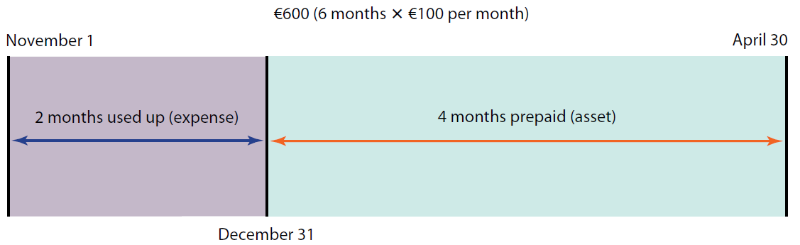
Prepaid Expenses
LO2
Illustration

Slide 32
Prepaid Expenses
LO2
Illustration
The adjusting journal entry to bring the original amounts to their updated balance at year-end is:
Dec. 31
Insurance Expense
200
Prepaid Insurance
200
To record insurance expense for two months: 2 x €100 = €200.
Prepaid Insurance
Cash
Insurance Expense
Original entry (11/1/17)
600
600
Adjusting entry (12/31/17)
200
200
Updated bal. (12/31/17)
400
200
To balance sheet
To statement of
comprehensive income

Slide 33
Prepaid Expenses
LO2
Illustration
On December 15, 2017, you purchased several months’ of supplies (fertilizer, weed killer, etc.) at a total cost of €350.
At year-end, supplies costing €225 were still on hand.
Dec. 15
Supplies on Hand
350
Cash
350
Purchased supplies.

Slide 34
Prepaid Expenses
LO2
Illustration
The adjusting journal entry to bring the original amounts to their updated balance at year-end is:
Dec. 31
Supplies Expense
125
Supplies on Hand
125
To record the use of supplies.
Supplies on Hand
Cash
Supplies Expense
Original entry (12/15/17)
350
350
Adjusting entry (12/31/17)
125
125
Updated bal. (12/31/17)
225
125
To balance sheet
To statement of
comprehensive income

Slide 35
Unearned Revenues
LO2
Cash amounts received before its corresponding revenue can be recognized.
The advance payment: A debit to Cash and a credit to liabilities (Unearned Revenues).
In the future the company must provide something (selling goods or providing services) in return for the amounts received.
A debit to Unearned Revenue, and a credit to Revenue

Slide 36
Unearned Revenues
LO2
Illustration
Assume the following about your Landscaping company:
On December 1, a client pays you €225 for three months of landscaping services to be provided for the period beginning December 1, 2017, and ending February 28, 2018.
Dec. 1
Cash
225
Unearned Revenue
225
Received three months’ revenue in advance:
€75 × 3 = €225.

Slide 37
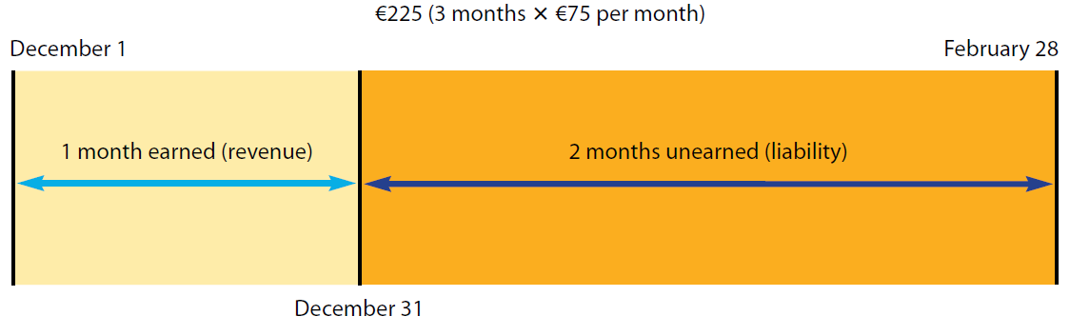
Unearned Revenues
LO2
Illustration

Slide 38
Unearned Revenues
LO2
Illustration
The Landscaping company will record the following adjusting entry:
Dec. 31
Unearned Revenue
75
Landscaping Revenue
75
To record Landscaping revenue for one month:
€75 × 1 month = €75.
Landscaping
Revenue
Unearned Revenue
Cash
Original entry (12/1/17)
225
225
Adjusting entry (12/31/17)
75
75
Updated bal. (12/31/17)
150
75
To balance sheet
To statement of
comprehensive income

Slide 39
Adjusting Entries
LO2
Two Characteristics Of Adjusting Entries
Adjusting entries made at the end of an accounting period do not involve cash.
Each adjusting entry involves a balance sheet account and an account on the statement of comprehensive income.

Slide 40
Quiz Yourself
LO2
For each of the following items, prepare the adjusting entry necessary on December 31.
On June 1, the company purchased a €100,000 certificate of deposit (CD). The CD earns 6% per year. Principal and interest on this investment will be collected next year on May 31.
(Not required) The initial journal entry on June 1 is as follows:
The adjusting entry on December 31 is as follows:
Jun. 1
Certificate of Deposit (asset)
100,000
Cash
100,000
Dec. 31
Interest Receivable (€100,000 × 0.06 × 7/12)
3,500
Interest Revenue
3,500

Slide 41
Quiz Yourself
LO2
On August 1, the company paid €12,000 cash for rent for one year beginning on August 1.
(Not required) The initial journal entry on August 1 is as follows:
The adjusting entry on December 31 is as follows:
Aug. 1
Prepaid Rent
12,000
Cash
12,000
Dec. 31
Rent Expense (€12,000 × 5/12)
5,000
Prepaid Rent
5,000

Slide 42
Quiz Yourself
LO2
On October 1, the company received €18,000 cash for consulting services that it will provide evenly over 12 months starting on October 1.
(Not required) The initial journal entry on October 1 is as follows:
The adjusting entry on December 31 is as follows:
Oct. 1
Cash
18,000
Unearned Consulting Revenue
18,000
Dec. 31
Unearned Consulting Revenue
4,500
Consulting Revenue (€18,000 × 3/12)
4,500

Slide 43
Quiz Yourself
LO2
The company pays its employees on the 15th of each month. The total amount paid each month is €80,000. [ Note: Round your calculations to the nearest half month; don’t worry about counting the exact number of days in December.]
The adjusting entry on December 31 is as follows:
Dec. 31
Wages Expense (€80,000 × 1/2)
40,000
Wages Payable
40,000

Slide 44
Financial Statements Preparation
Preparing Financial Statements
LO3
Process of Financial Statements Preparation
Identify all revenues and expenses
These account balances are used to prepare the statement of comprehensive income.
Compute net income
Subtract expenses from revenues.
Compute the ending retained earnings balance
Retained Earnings from the previous period is the starting point.
Net income is added to the beginning retained earnings balance.
Prepare a balance sheet
By using trial balance to prepare and the updated retained earnings balance computed from step 3.

Slide 45

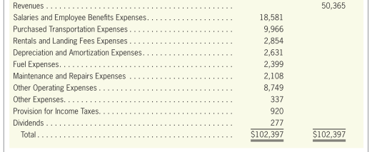
Financial Statements Preparation
LO3
Illustration—FedEx Corporation
Exhibit 4.3
Simplified Adjusted
Trial Balance
…
Statement of
Comprehensive Income
Computing the ending retained earnings balance

Slide 46
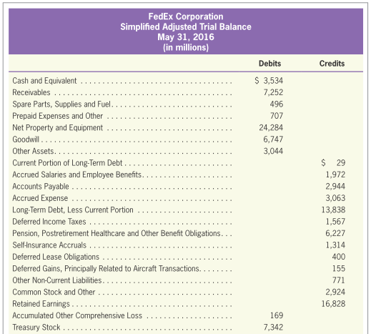
Financial Statements Preparation
LO3
Illustration—FedEx Corporation
Simplified Adjusted
Trial Balance
Balance Sheet
Computing the ending retained earnings balance
Exhibit 4.3
…

Slide 47
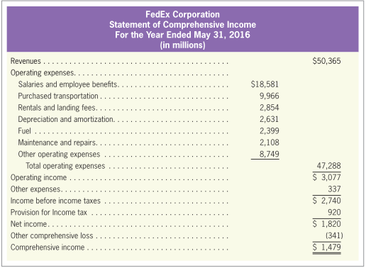
Financial Statements Preparation
LO3
Illustration—FedEx Corporation
Statement of
Comprehensive Income
Exhibit 4.4

Slide 48
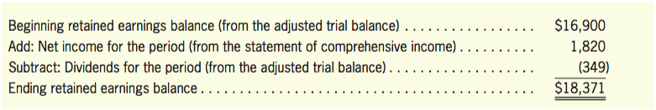
Financial Statements Preparation
LO3
Illustration—FedEx Corporation
Computing the ending retained earnings balance
Balance Sheet

Slide 49
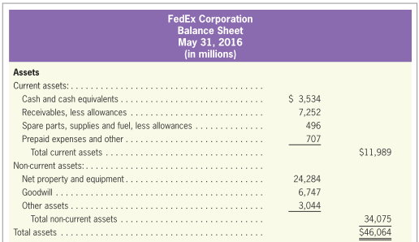
Financial Statements Preparation
LO3
Illustration—FedEx Corporation
Balance Sheet
Exhibit 4.5

Slide 50
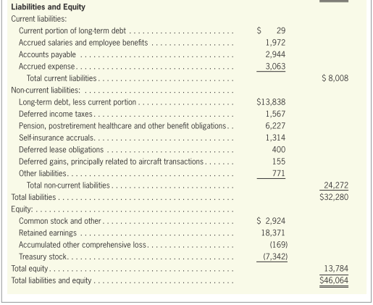
Financial Statements Preparation
LO3
Illustration—FedEx Corporation
Balance Sheet
(Continued)
Exhibit 4.5

Slide 51
The Notes
LO3
The notes to the financial statements tell about:
The assumptions and methods used in preparing the financial statements.
More detail about specific items.
To highlight the importance of the notes, many financial statements have the following message printed at the bottom: “the notes are an integral part of these financial statements.”

Slide 52
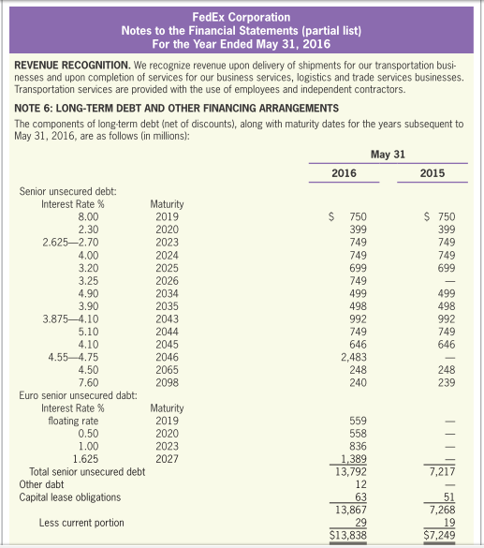
The Notes
LO3
Illustration—FedEx Corporation
Notes
to the Financial Statements
The first note illustrates how financial statement notes can summarize the accounting policies and assumptions.
This provides detailed information about a summary number that was reported in the financial statements.
Exhibit 4.6

Slide 53
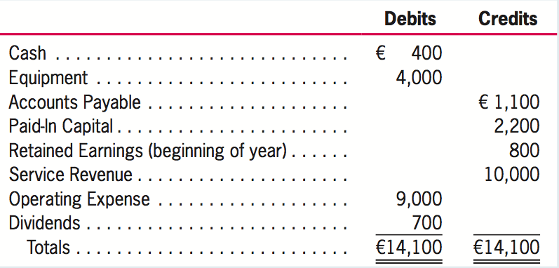
Quiz Yourself
LO3
Prepare a balance sheet and a statement of comprehensive income using the data in Newton Company’s adjusted trial balance below (as of December 31, 2017).

Slide 54
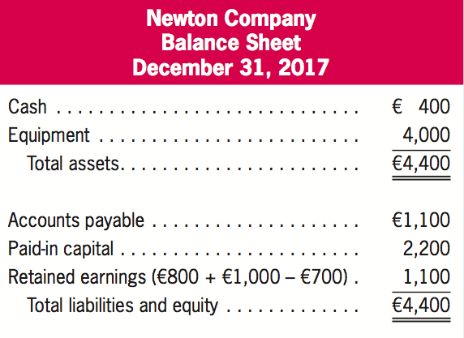
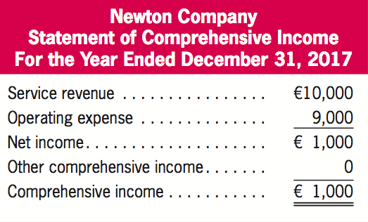
Quiz Yourself
LO3
Solution
Note that although net income equals comprehensive income in this case, it is net income, instead of comprehensive income, that is added to the beginning balance of retained earnings in determining the ending balance of retained earnings.

Slide 55
Closing the Books
Closing the Books
LO4
The Accounting Cycle Has Included the Following:
Analyzing documents
Journalizing transactions
Posting to the ledger accounts
Determining account balances
Preparing a trial balance
Making adjusting entries
Preparing the financial statements
Two additional steps are needed:
Journalizing and posting closing entries
Preparing a post-closing trial balance

Slide 56
Closing the Books
LO4
Real Accounts
Permanent:
Not closed at year end.
Balance sheet accounts
Balances are carried forward to next period.
Nominal Accounts
Temporary
Closed (brought to a zero balance) at year end.
Subcategories of Retained Earnings
Balances are NOT carried forward to next period.

Slide 57
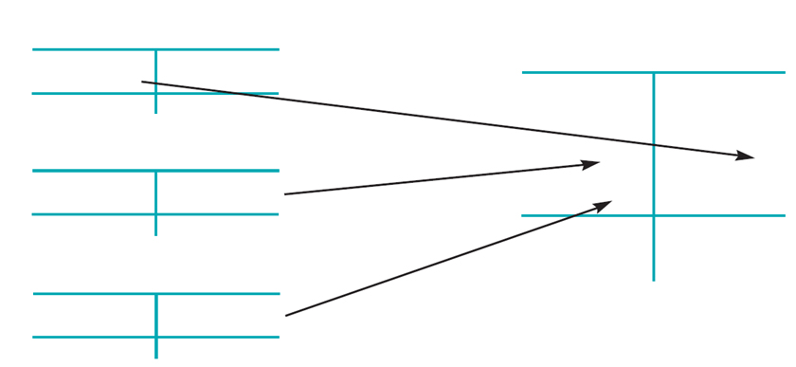
Closing Entries
LO4
The Closing Process
Revenues
(Nominal Accounts)
Retained Earnings
(Real Account)
xxx Bal. xxx
To close
Beg. Bal. xxx
Expenses
(Nominal Accounts)
Total Expenses
xxx
xxx
To close
Total Revenues
Bal. xxx xxx
Dividends
xx
Dividends
(Nominal Accounts)
End. Bal. xxx
To close
Bal. xx xx
Exhibit 4.7

Slide 58
Closing Entries
LO4
Debit the
revenues
The Closing Entries of FedEx
May. 31
Revenues
50,365
Salaries and Employee Benefits Expenses
18,581
Credit the
expenses
Purchased Transportation Expenses
9,966
Rentals and Landing Fees Expenses
2,854
A Net Income is closed (credited) to the Retained Earnings.
A Net Loss is closed (debited) to the Retained Earnings.
Depreciation and Amortization Expenses
2,631
Fuel Expenses
2,399
Maintenance and Repairs Expenses
2,108
Other Operating Expenses
8,749
Other Expenses
337
Provision for Income Taxes
920
Retained Earnings
1,820

Slide 59
Closing Entries
LO4
Closing the Dividends
Nominal account but NOT an expense.
When dividends are first declared:
Dividends XXX
Dividends Payable XXX
When dividends are paid:
Dividends Payable XXX
Cash XXX
To close dividends at year end:
Retained Earnings XXX
Dividends XXX

Slide 60
Closing Entries
LO4
The Closing Entries of FedEx
May. 31
Retained Earnings
277
Dividends
277
Credit the
dividends

Slide 61
Preparing a Post-Closing Trial Balance
LO4
Post-Closing Trial Balance
A listing of all real account balances after the closing process has been completed.
Testing whether total debits equal total credits prior to beginning a new accounting cycle.
For internal purpose only and is designed to provide assurance that previous steps performed properly.

Slide 62
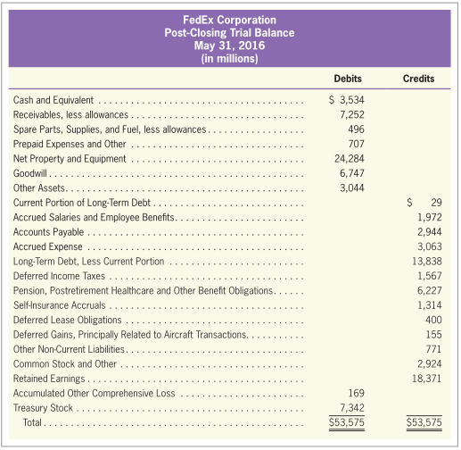
Post-Closing Trial Balance
LO4
Illustration—FedEx Corporation
Exhibit 4.8

Slide 63
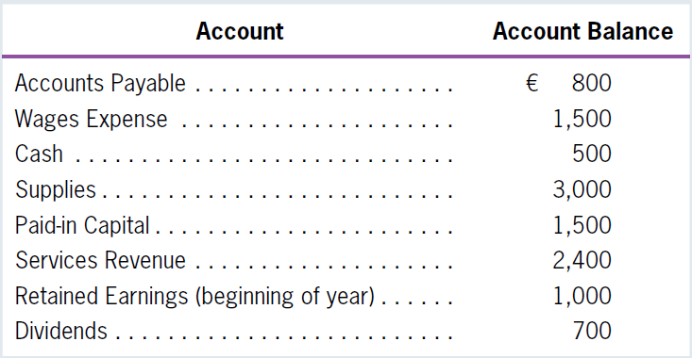
Quiz Yourself
LO4
Prepare all necessary closing entries for Joyce Company, which had the following account balances on December 31.

Slide 64
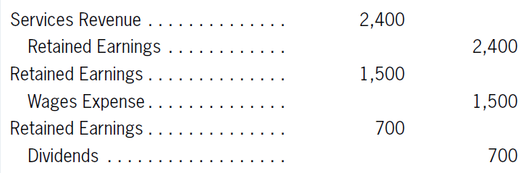
Quiz Yourself
LO4
Solution
Remember that only the nominal accounts (revenues, expenses, and dividends) are closed to Retained Earnings. The real accounts (cash, supplies, accounts payable, and paid-in capital) are maintained and their balances are carried forward to the next year.

Slide 65
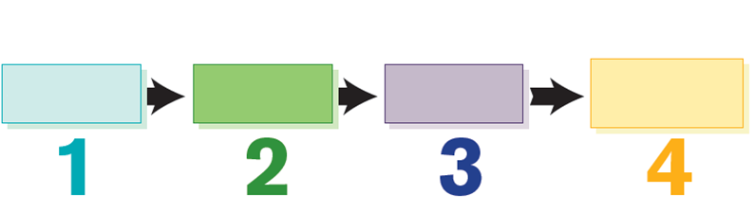
A Summary of the Accounting Cycle
A Summary of the Accounting Cycle
LO5
Accounting Cycle
Analyze transactions.
Record the effects of
transactions.
1
2
Exchange Transactions
(Business enter into exchange transactions
signaling the beginning of the accounting cycle)
Step
Step
Summarize the effects of
transactions.
1 Posting journal entries.
2 Preparing a trial balance.
Prepare reports.
1 Adjusting entries.
2 Preparing financial statements.
3 Closing the books.
3
4
Exhibit 4.9
Step
Step

Slide 66
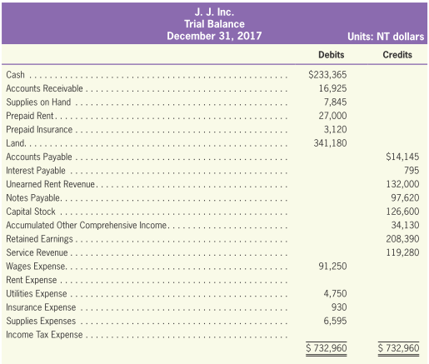
Illustration of the Last Step in the Accounting Cycle
LO5
Unadjusted Trial Balance

Slide 67
Illustration the Last Step in the Accounting Cycle
LO5
Preparing Adjusting Entries
A physical count at December 31 shows that NT$5,895 of supplies is still on hand.
The company rented an office for a year and paid a full rental fee of NT$27,000 in cash on October 1.
Dec. 31
Supplies Expense
1,950
Supplies on Hand
1,950
The account “Supplies on Hand” has a debit balance of NT$7,845 before adjustment; it suggests that Supplies on Hand should be reduced by NT$1,950.
Dec. 31
Rent Expense
6,750
Prepaid Rent
6,750
At the end of the year, 3-month rent expense must be recognized (NT$27,000 ÷ 12 months ⨉ 3 months = NT$6,750) and at the same time, the prepaid rent is to be decreased by NT$6,750.

Slide 68
Illustration the Last Step in the Accounting Cycle
LO5
Preparing Adjusting Entries
The company purchased a one-year fire insurance for NT$3,120 and paid in advance on July 1.
Wages earned by employees in December 2017 are NT$7,500, and yet they will not be paid until January 5, 2018.
Dec. 31
Insurance Expense
1,560
Prepaid Insurance
1,560
At the end of the year, six months of insurance expense (NT$3,120 ÷ 2 = NT$1,560) should be recognized and at the same time, the prepaid insurance is to be decreased by NT$1,560.
Dec. 31
Wages Expense
7,500
Wages Payable
7,500
The wages earned by the employees should be recognized as an expense and an increase in liabilities is also to be recorded at the end of 2017.

Slide 69
Illustration the Last Step in the Accounting Cycle
LO5
Preparing Adjusting Entries
On December 15, 2017, a bill for NT$235 was received for utilities, but it will not be paid until January 15, 2018.
On September 1, the company rented its land to Fox Co. for a year and received a full year rent of NT$132,000 in cash.
Dec. 31
Utilities Expense
235
Utilities Payable
235
The utilities expense should be recognized as an expense in 2017 and an increase in liabilities is also to be recorded at the end of 2017.
Dec. 31
Unearned Rent Revenue
44,000
Rent Revenue
44,000
At the end of the year, a 4-month rent revenue (NT$132,000 ÷ 12 months ⨉ 4 months = NT$44,000) should be recognized and at the same time, the liability is decreased.

Slide 70
Illustration the Last Step in the Accounting Cycle
LO5
Preparing Adjusting Entries
The company's income is taxed at a rate of 5%.
Dec. 31
Income Tax Expense
2,088
Income Tax Payable
2,088
After making the above adjusting entries, the difference between total revenues and total expenses is NT$41,760, which is income before income tax. Therefore, income tax expense of NT$2,088 should be recognized and an increase in liabilities is also to be recorded.

Slide 71
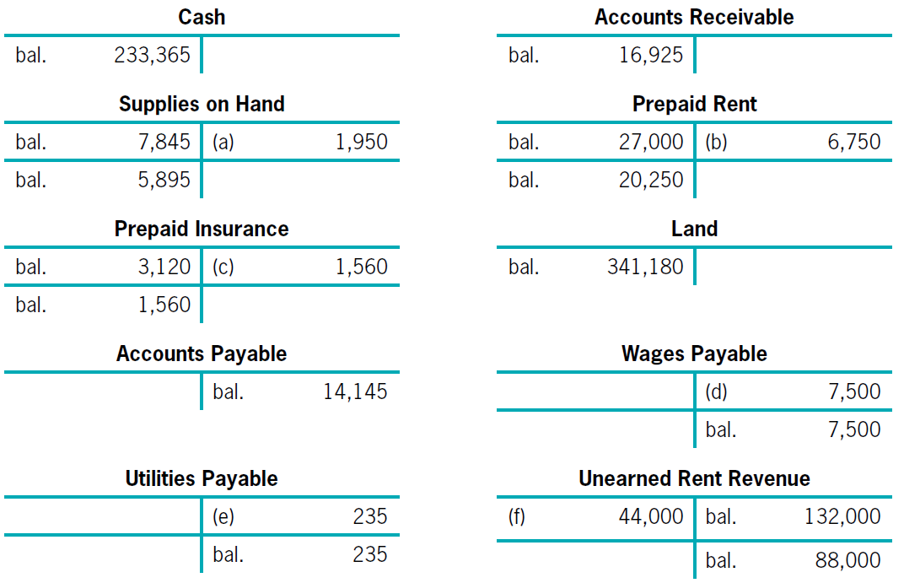
Illustration the Last Step in the Accounting Cycle
LO5
Posting to the Ledger Accounts

Slide 72
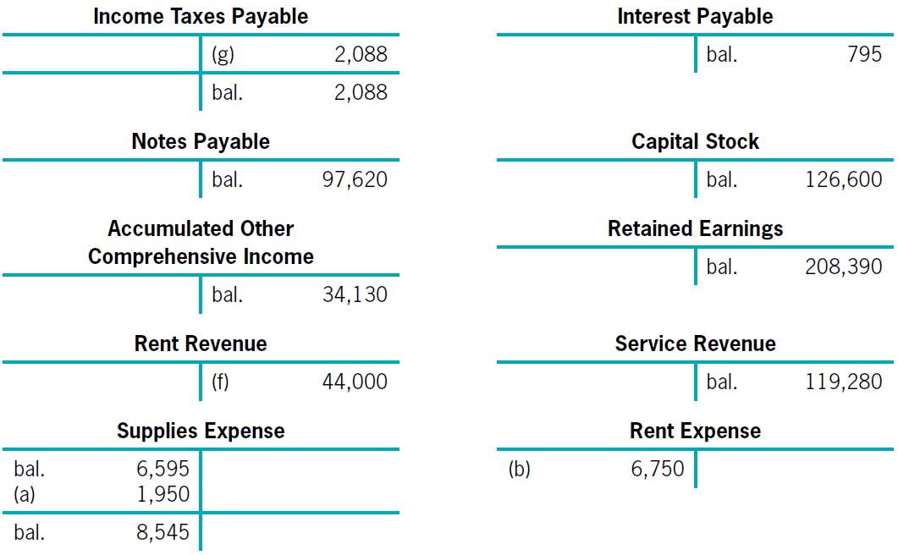
Illustration the Last Step in the Accounting Cycle
LO5
Posting to the Ledger Accounts

Slide 73
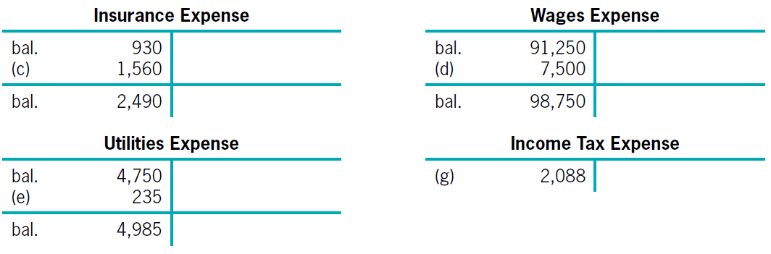
Illustration the Last Step in the Accounting Cycle
LO5
Posting to the Ledger Accounts

Slide 74
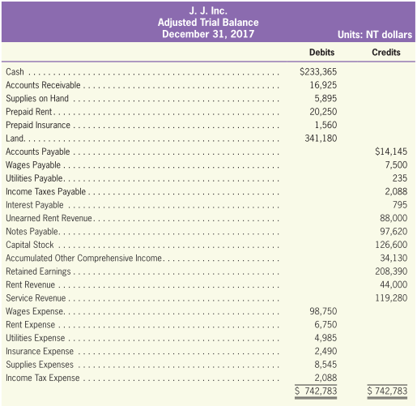
Illustration the Last Step in the Accounting Cycle
LO5
Adjusted Trial Balance

Slide 75
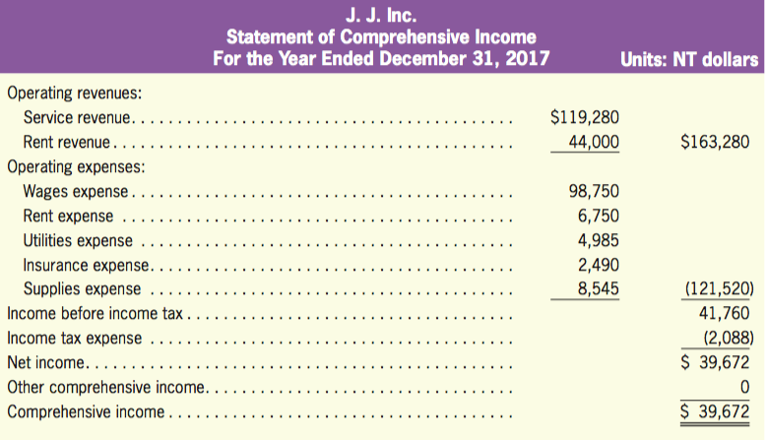
Illustration the Last Step in the Accounting Cycle
LO5
Statement of Comprehensive Income

Slide 76
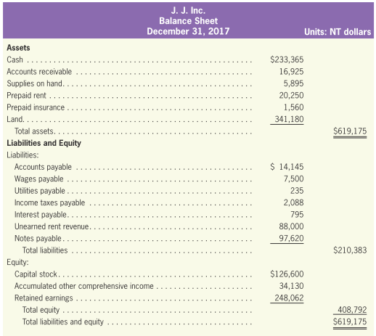
Illustration the Last Step in the Accounting Cycle
LO5
Balance Sheet
net income
$208,390 + $39,672

Slide 77
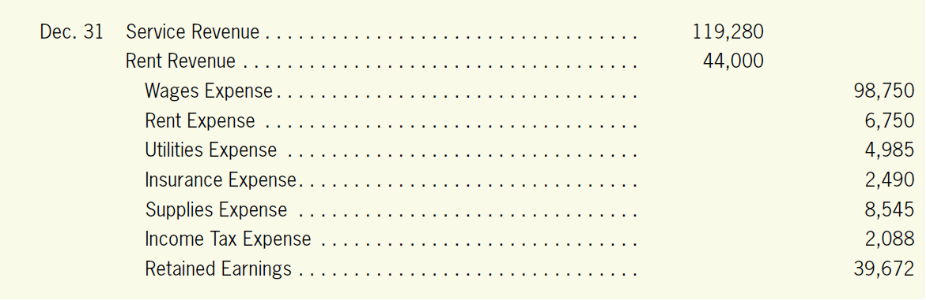
Illustration the Last Step in the Accounting Cycle
LO5
Preparing Closing Entries

Slide 78
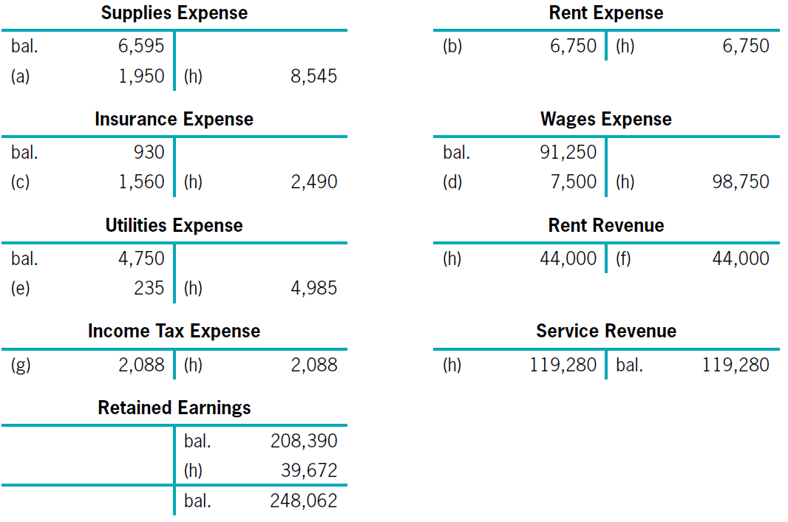
Illustration the Last Step in the Accounting Cycle
LO5
Preparing Closing Entries

Slide 79
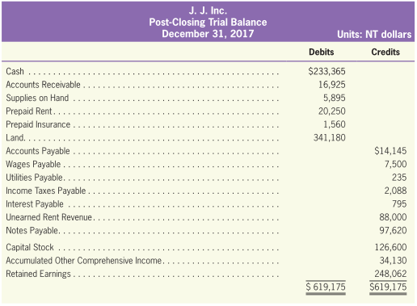
Illustration the Last Step in the Accounting Cycle
LO5
Post-Closing Trial Balance
Units: NT dollars

